Slide 1


Automotive engineering Teaching tool with interactive assistive elements
WSS551 Interactive Design for Web Systems - Spring 2022
Marios Pafitis
Vasileios Samaras

Slide 2
The PROBLEM
Automotive engineering learning at high school is complicated due to the lack of visuals.
Conceptual thinking is the key to become an engineer but currently isn’t practiced at school.
Static content (images, text) may lead to misconceptions when describing the assembly of an automotive system.
Quizzes in automotive systems’ assembly are hard to be prepared and conducted in paper.

Slide 3
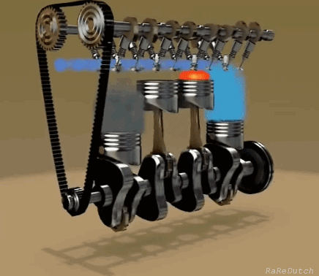
The idea:
What if we could have a concise interactive tool to simplify the learning process of a complex mechanism?
“ Learn Automotive Engineering TheMech way!’’
Visual learning of automotive vehicle systems
Practice conceptual thinking
Adjust the learning material based on your experience
Conduct quizzes in automotive vehicle systems assembly easily
Interact with 3D visualizations of vehicle systems with AR and MR

Slide 4
ADVANTAGES OF
Affordable
[ Other competitor’s learning platforms are expensive. We provide our system for free, making revenue through community subscription ]
User experience comes first!
[ Other learning platforms are limited to static content with photos, videos and information. We provide interactive points of interest (contextual enhancements by hovering) and information layers over 3D elements]
Crowdsourcing
[ Every teacher contributes on the creation of a database with lectures and quizzes for the different automotive systems.]
Make the most out of productivity.
Teachers can enhance their lesson with interactive content,
Students can exercise and realize the system presented together with a quiz,
Both can attain straightforward valuable feedback metrics.

Slide 5
More Advantages
Interactive learning
[ An easier and smarter way to create customized web applications appending layers of 2D, 3D and pseudo-3D images over a basic background layer is introduced.]
Minimum resources
[ Our aim is to use as little hardware resources (internet bandwidth, GPU utilization, CPU utilization) as possible while maintaining the learning levels high.]
Responsive design
[ Since, our web application will be used by mostly students, and usually students use their smartphones for accessing the internet, a lightweight system designed to be responsive and enjoyable. ]
[ *At current stage, we use 2D images for illustrating the different systems,
and in the future, we will test 3D images, videos or AR and VR ]

Slide 6

Who Uses
The typical users of the system consist of two main categories:
(i) Teachers
Use the system as an assistive tool to improve the efficacy of their job.
Create interactive lectures.
Create interactive quizzes that can test the assembly of different systems.
Monitors students progress.
(ii) Students
Learn automotive systems through interactive visuals.
Test their knowledge through interactive quizzes.
Record their progress.
Adjust the level of difficulty.

Slide 7

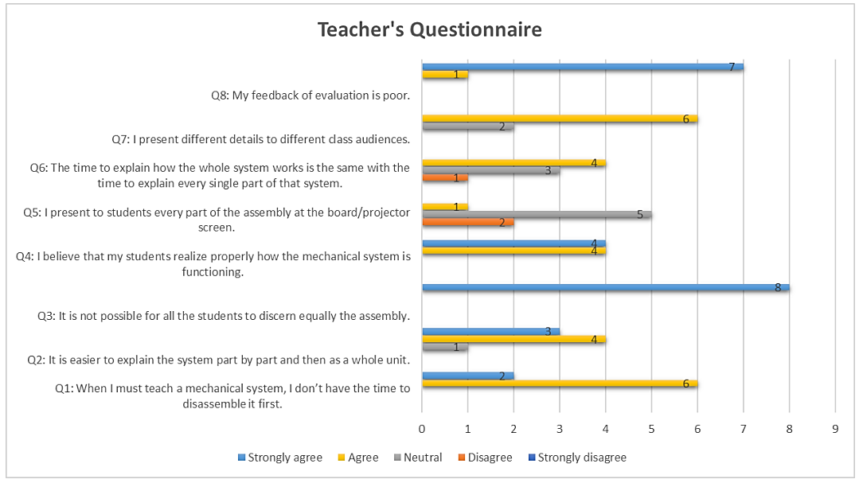
We interviewed
8 teachers!

Slide 8
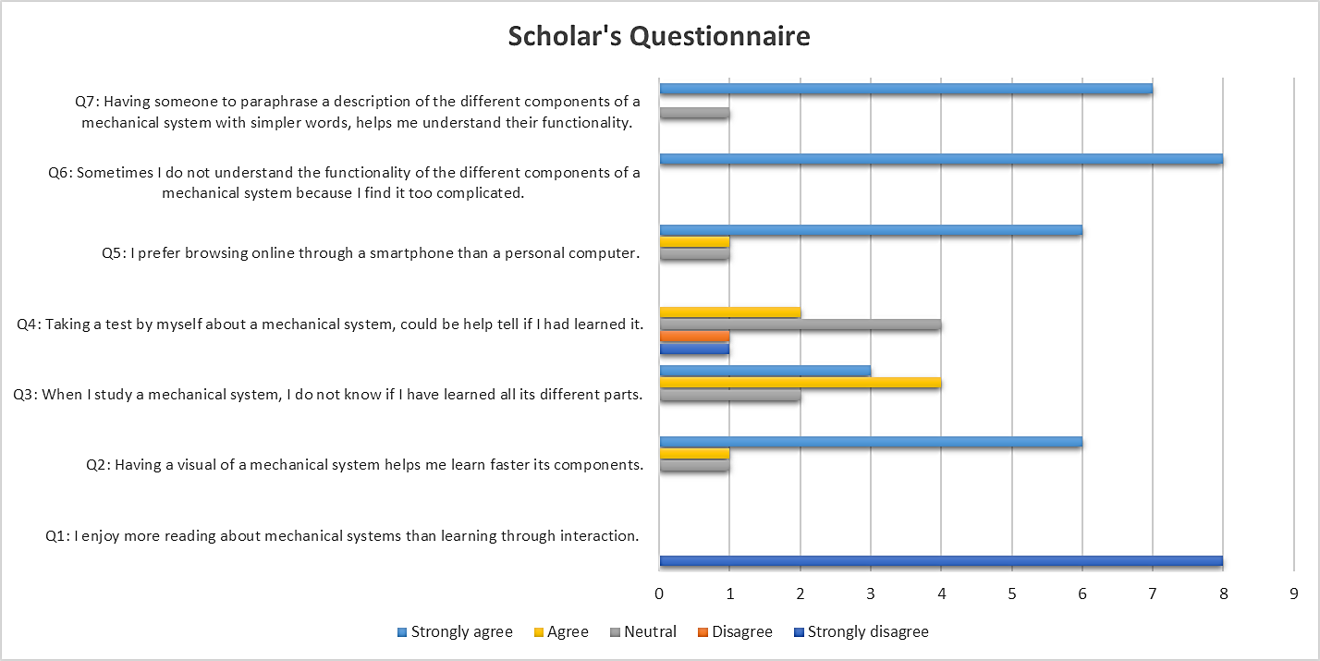
And 8 students!

Slide 9
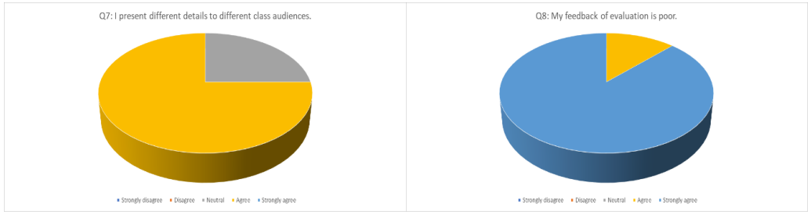
What we learned!
1.
Teachers find it difficult to demonstrate the functioning of a mechanical system so as for the student to realize it. Each part of the system needs to be visualized alongside the overall assembly.

Slide 10
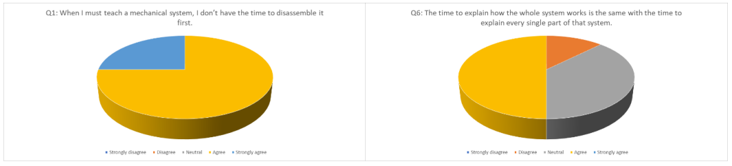
we learned Also that…
2.
Teachers have limited time to spend on teaching every system.

Slide 11
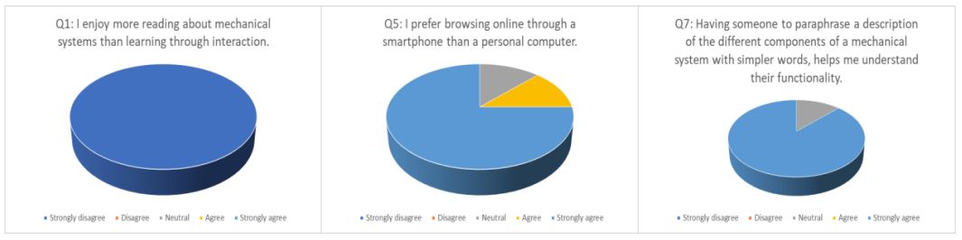
Finally, WE learned That…
3.
Students may need someone to explain a concept with simpler works.
4.
Students prefer to use their smartphone than their personal computer (may not have access to one).

Slide 12
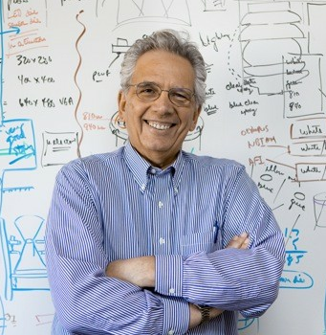
Persona 1
Name: Kikkos Kikkou
Occupation: Technical School Instructor
Age: 52
Status: Married + 4 children
Bio:
He is 11 years at education public sector and was 12 years at heavy-duty tractor services. Has basic knowledge in computers and the English language. Obtained a BSc in Mechanical Engineering. Teaches a series of automotive technology lessons.
As an automotive expert, he can easily handle machinery and mechanical systems. Usually, spends his most time at the school laboratories preparing his everyday lectures and practical workshops on basic automotive systems.

Slide 13
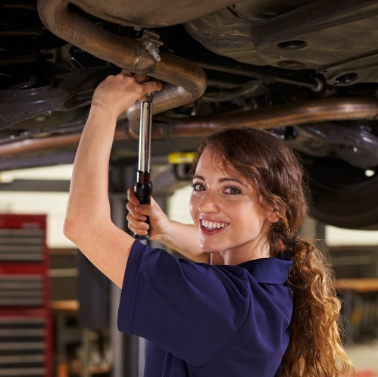
Persona 2
Name: Maria Andreou
Occupation: Cyprus Technical School Student
Age: 16
Bio:
She studies vehicle engineering. She usually plays with and services her 50cc motorbike. She spends a lot of time watching tic-toc and talking with boys. She is an average student and has poor English knowledge. Usually in the class she feels boring. After schools she helps at her father’s business.

Slide 14
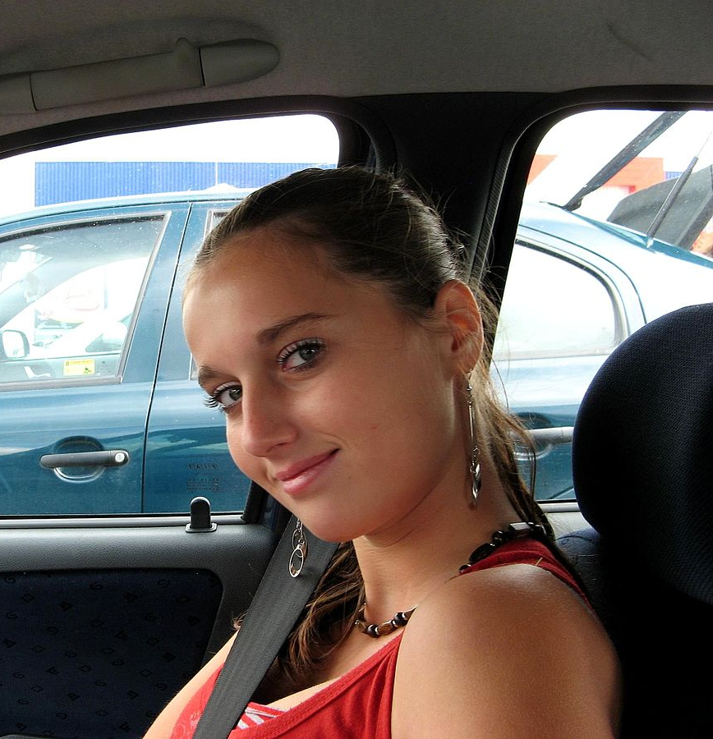
Scenario Example
Maria has been playing all the afternoon at her 50cc motorbike since she came home after school. Tomorrow, she has a test at school about the suspension system of vehicles. She is so tired and bored to read all the theoretical material that her tutor has provided them.
As an alternative, she tries to study the basics on the website, since she uses it as a refence for her 50cc motorbike repairments as well. She browses for the suspension system in the learning section and selects the difficulty level to high school students. She hovers the mouse above the different components of the beautiful visuals, to reveal their functionality.
After 20 minutes, she leaves the house to hang out with her friends. While being in the car, she opens the website in her smartphone to study a little bit more. From the menu, she loads the system again and by pressing the different points of interests she reveals their description.

Slide 15
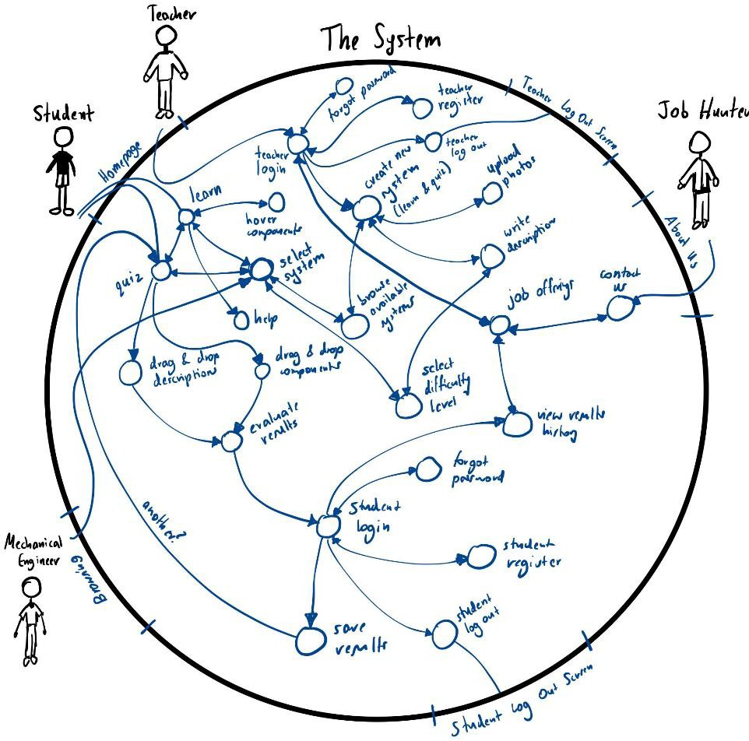
SITE PATH
With the site path we tried to explore different types of users and how they can potentially access our website. For example:
Teacher: Homepage
Student: Homepage
Mechanical Engineer: Browsing
Job Hunter: About us

Slide 16
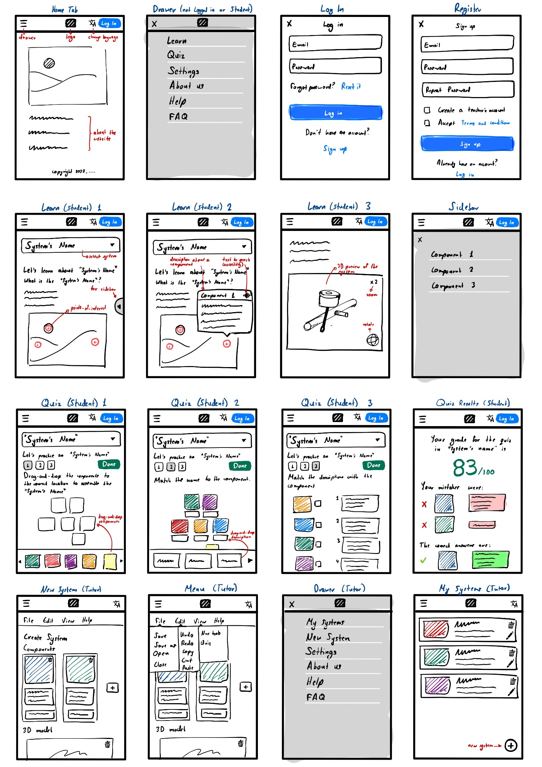
Prototype Design - Application
Low fidelity prototype for the application view to understand how the different elements will adapt in a smartphone screen. Based on the scenario mentioned earlier we understood that most of the students will be using our website in their smartphone.

Slide 17
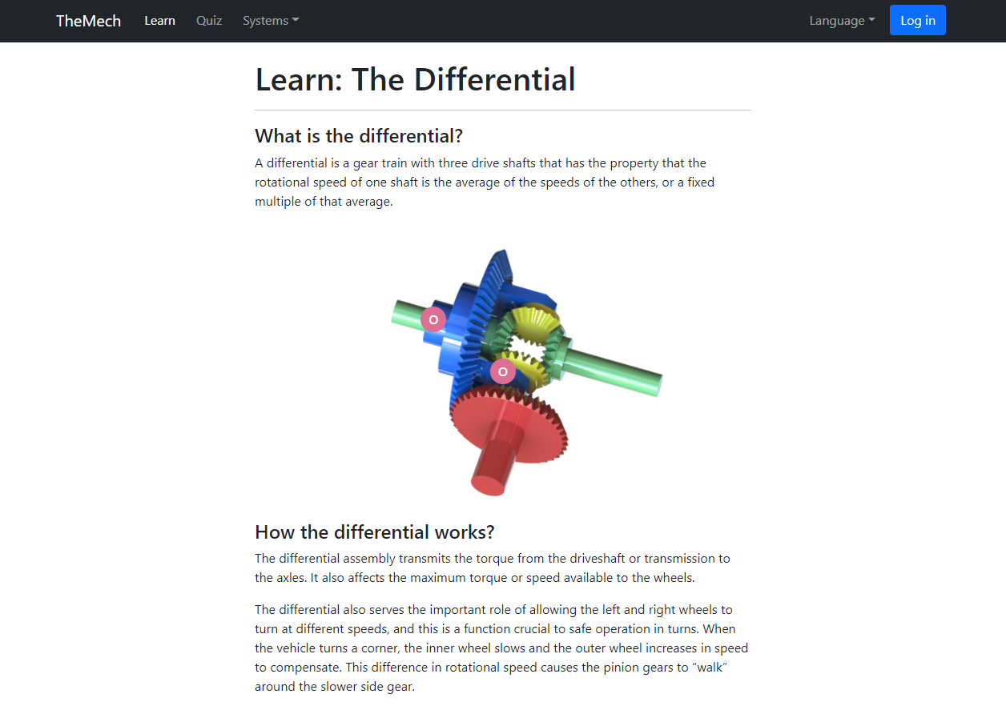
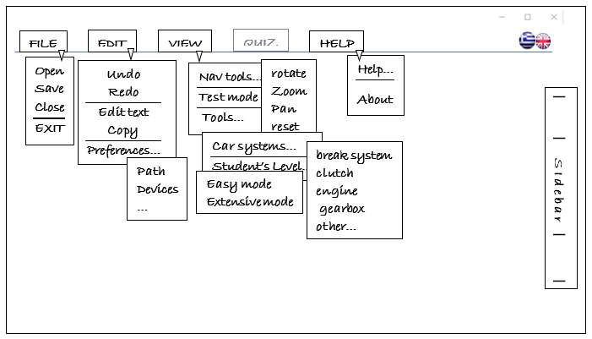
Prototype Design – Web (1)
Low fidelity, throw-away prototype focusing mostly on the teacher’s requirements. It demonstrates how a teacher can create and modify a vehicle system.
Medium fidelity prototype created with Bootstrap, HTML, CSS and JavaScript. It demonstrates the basic functionalities such as drop-down menus, drag-and-drop etc.

Slide 18
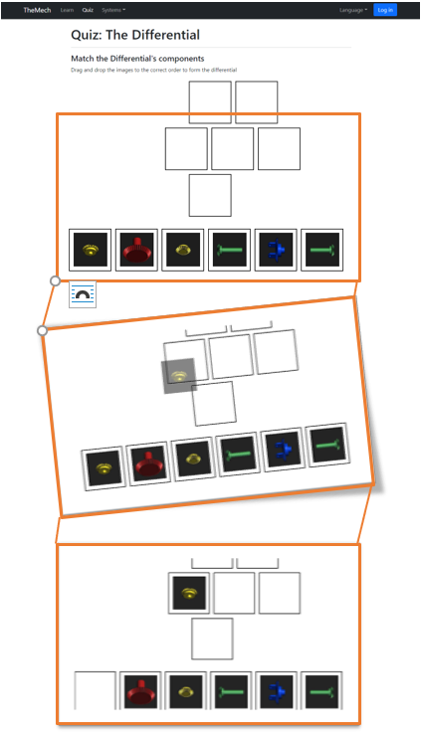
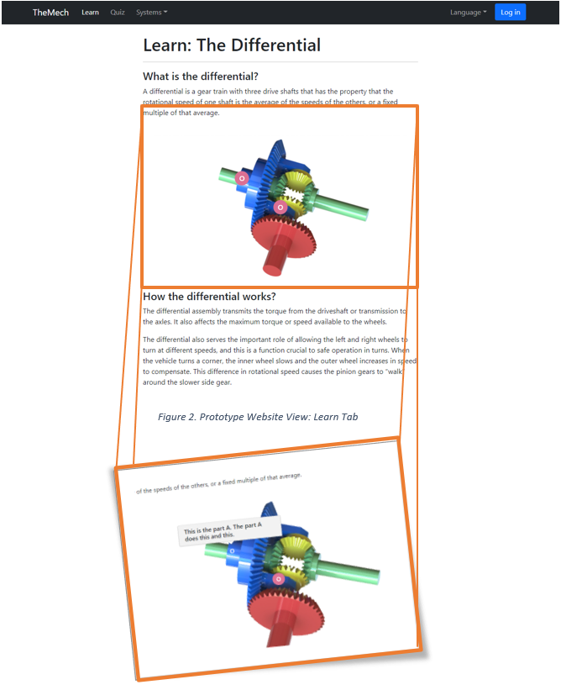
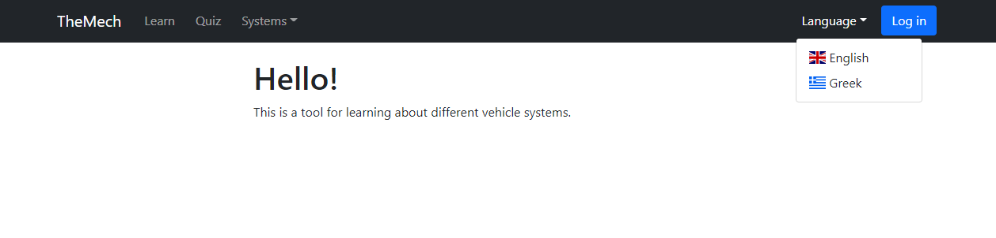
Prototype Design – Web (2)
Learn:
See a 3D preview of the system and hover the mouse above the components to learn about their functionality.
Quiz:
Drag-and-drop the system’s components to assemble it.
“Our potential users find the design user friendly and straightforward. “

Slide 19
requirements
Functional
Non-Functional
Home Tab: Log in, change language, about us, help
Log In: Reset password and register if new user.
Register: Specify account type (teacher/student)
Learn: Read information about a system, view the system in 3D images, learn about different components with mouse hovering, change difficulty.
Quiz: Drag-and-drop the components to assemble the system and match their names and descriptions. Save the progress of the user upon completion.
Teacher: Create lectures and quizzes by uploading 3D images, descriptions and specifying points of interest and how to assemble them.
Help: Provide user support and access to FAQ
Accessibility: Support blind people by providing audio for the different text (text-to-speech). Audio navigation and captions for the images.
Security: Encrypt passwords, use secure hosting server, SSL certificates and Cloudflare to avoid DDOS.
Ads: Show relevant ads for mechanics (Income).
Language: Change language (Greek, English)
Dark Mode: Switch between light and dark mode.
Data Management
Both: Email, password, full name, account type
Student: Progress in lectures and quizzes (grades)
Teacher: Saved vehicle systems, student results.

Slide 20
Specifications
Hardware
Software
Hosted in a hosting service online (e.g., Hostinger, Amazon AWS)
For testing the web application, a private localhost server shall be used.
3D VR glasses (desktop) or a camera for AR (mobile) shall be used in the final product to see in the real world the scale of the different components of a mechanical system.
MEAN stack
MongoDB - MongoDB Compass
Express.js
Angular.js
Node.js
HTML, CSS, Bootstrap, JavaScript
Three.js (library for 3D rendering)
Input/Output
Technical Restrictions:
Desktop: mouse (left-click, hover, scroll)
Mobile: touch
Mobile: In the mobile devices since hover is not available, after clicking on a component its description will become visible, while in the desktop after hovering above it.
WIMP (Windows, Icons, Menus, Pointers) easy to use interface for uploading models and their descriptions as an educator.

Slide 21


Slide 22
STRUCTURE
root
assets
css
js
routes
index.js
node_modules
index.html
images
quiz.css
drag_drop.js
login.js
create_db.js
images.css
learn.js
register.js
package.json
navbar.css
navigation.js
lectures.js
package-lock.json
quizes.js
systems.js
users.js

Slide 23
/** index.js **/
var express = require("express"); // a minimal and flexible web application framework on top of Node.js web server
var app = express(); // enables interacting with the file system
var fs = require("fs"); // The Node.js file system module allows for work with the computer's file system
var bodyParser = require("body-parser"); // parses the JSON, buffer, string and URL encoded data submitted
var __dirname = "./";
app.use(express.static("assets")); //to enable static content
app.use(bodyParser.urlencoded({ extended: false }));
app.use(bodyParser.json());
app.use("/bootstrap_css", express.static(__dirname + "/css/bootstrap/dist/css")); // include bootstrap
app.use("/bootstrap_js", express.static(__dirname + "/css/bootstrap/dist/js"));
app.use("/css", express.static(__dirname + "/css")); // include my css files from the /css folder
app.use("/js", express.static(__dirname + "/js")); // include my js files from the /js folder
app.get("/", function (req, res) { res.sendFile("index.html", { root: __dirname }); }); // load the single view file
/* Handlers */ var users = require("./routes/users.js"); // user queries - routing to users handler
app.use("/", users);
var login = require("./routes/login.js"); // login queries - routing to login handler
app.use("/", login); var register = require("./routes/register.js"); // register queries - routing to register handler
app.use("/", register); var lectures = require("./routes/lectures.js"); // lecture queries - routing to lectures handler
app.use("/", lectures);
var quizes = require("./routes/quizes.js"); // quiz queries - routing to quizes handler
app.use("/", quizes); var systems = require("./routes/systems.js"); // system queries - routing to systems handler
app.use("/", systems);
var server = app.listen(8081, function () {
var host = server.address().address;
var port = server.address().port;
console.log("Example app listening at http://%s:%s", host, port);
});

Slide 24
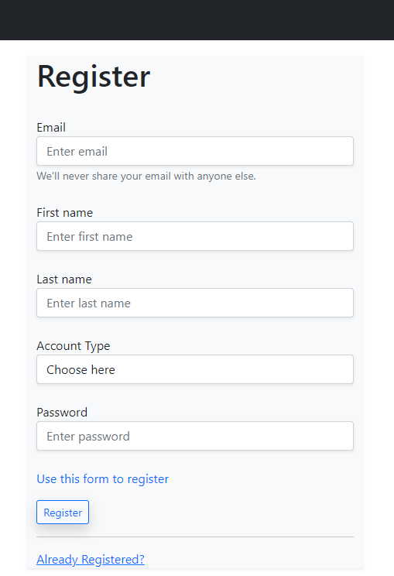
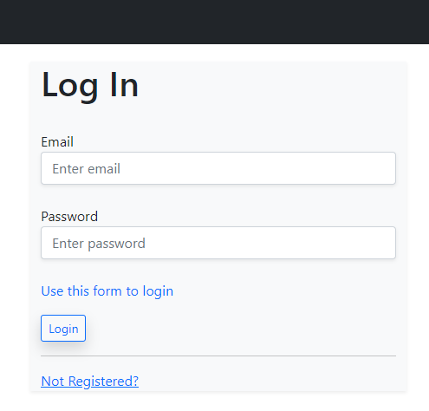
FUNCTIONALITY – Log In / Register
Both
Used the MEAN stack to implement the /login for Log In the user, checking the password and fetching his details such as the email, first name, last name, account type and progress for quizzes and lectures.
Used the MEAN stack to implement the /register to Register the user.
Bcrypt module was used for password encryption.
The account can be teacher or student.
All fields are required. Runs validation.
router.post("/login", function (req, res) { … });
router.post("/register", function (req, res) { … });

Slide 25
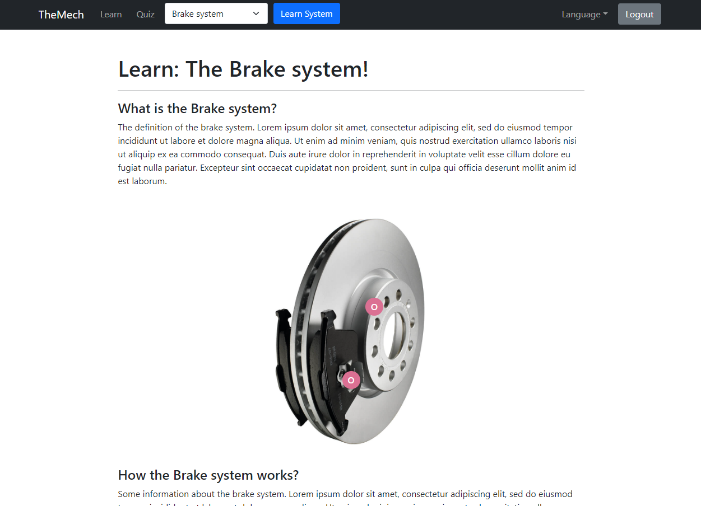
FUNCTIONALITY - Learn
As Student
Used the MEAN stack to implement the /getLecture/:id to fetch the lecture of the specified system with their description, points of interest, and image.
Used the MEAN stack to implement the /completeLecture to mark the lecture as completed for the specific user. Updates the user with the updateOne function.
Used JavaScript to implement the points of interests hovering that displays a description about the specific component.
router.get("/getLecture/:id", function (req, res) { … });
router.post("/completeLecture", function (req, res) { … });

Slide 26
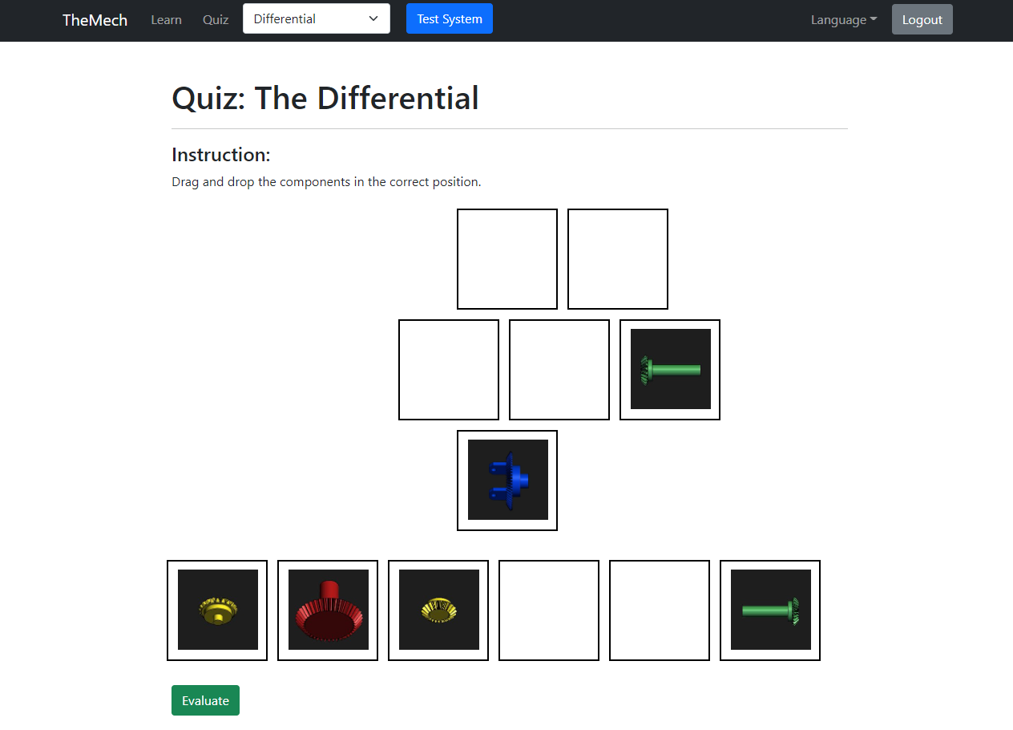
FUNCTIONALITY - Quiz
As Student
Used the MEAN stack to implement the /getQuiz/:id to fetch the quiz of the specified system.
Used the MEAN stack to implement the /completeQuiz to save the results (score). Updates the user with the updateOne function.
Used JavaScript to implement the drag-and-drop and the evaluation method that calculates the score (how many components are placed correctly).
router.get("/getQuiz/:id", function (req, res) { … });
router.post("/completeQuiz", function (req, res) { … });

Slide 27
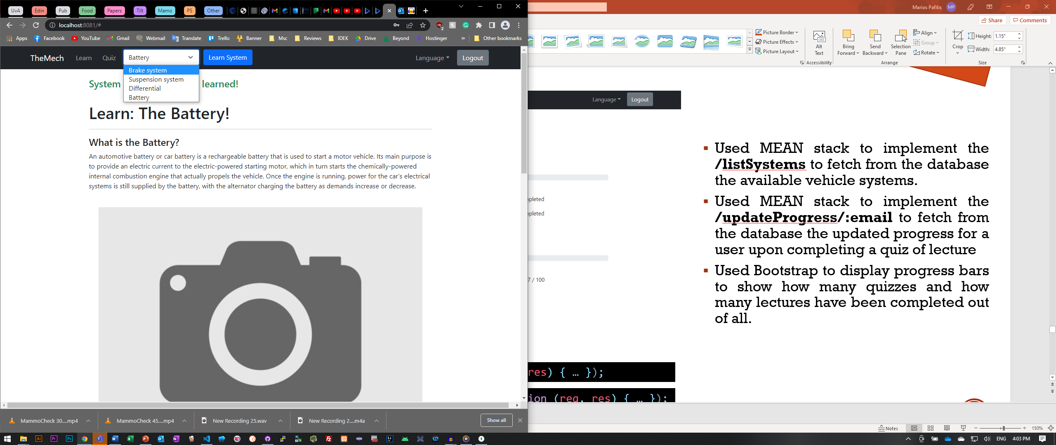
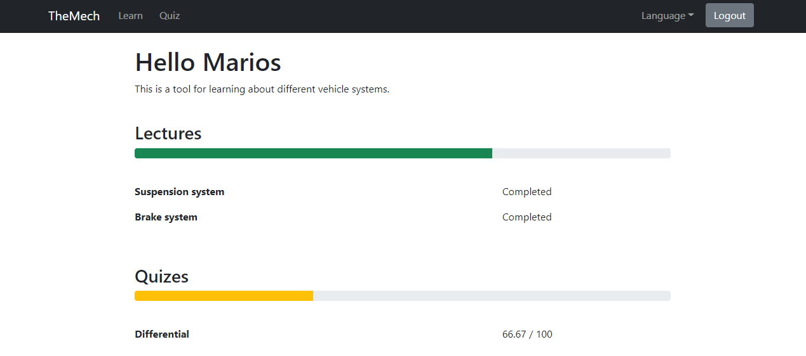
FUNCTIONALITY - UTILITIES
As Student
Used MEAN stack to implement the /listSystems to fetch from the database the available vehicle systems.
Used MEAN stack to implement the /updateProgress/:email to fetch from the database the updated progress for a user upon completing a quiz of lecture
Used Bootstrap to display progress bars to show how many quizzes and how many lectures have been completed out of all.
router.get("/listSystems", function (req, res) { … });
router.get("/updateProgress/:email", function (req, res) { … });

Slide 28
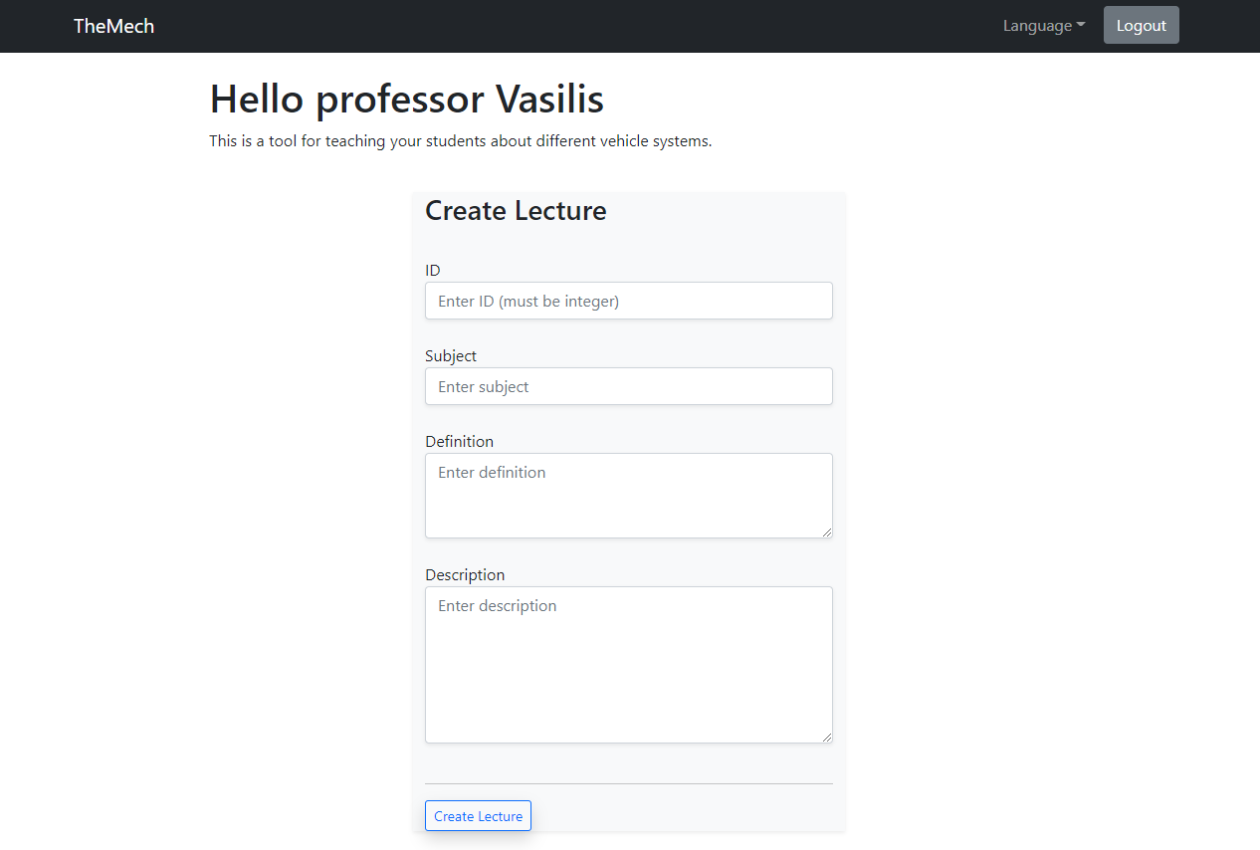
FUNCTIONALITY – ADD New System
As Teacher
Used Bootstrap to create a form.
Used the MEAN stack to implement the /addLecture to create a new lecture about a vehicle system. Initially ads the lecture in the lectures collections [1] and then after the next(); command inserts the new system to the systems collection [2].
router.post("/addLecture", function (req, res, next) { … [1] next(); }, function (req, res, next) { … [2] });

Slide 29
WHO DID WHAT
A clear analysis of the parts of the work done by each member of the group
Marios Pafitis
Design of the database structure.
Design the Navigation Bar, Learn page, Quiz page, and Home page with HTML/CSS and Bootstrap.
Implementation of Create/Complete Lecture, Evaluate Quiz, Fetch Progress and List Systems using the MEAN stack.
Implementation of drag-and-drop using JavaScript.
Implementation of the DOM representation behavior using Angular.js.
Implementation of the authentication encryption with the bcrypt module.
Vasileios Samaras
Design of the database structure.
Design of the Log In page and Register page using HTML/CSS and Bootstrap.
Implementation of the Login and Register behavior using the MEAN stack.
Implementation of the middleware and routing using Express.
Implementation of the DOM representation behavior using Angular.js.

Slide 30
FUTURE WORK
Integrate Augmented Reality (AR) and Mix Reality (MR).
Replace the 2D images with 3D models from the 3D model community.
Configure community subscription.
Implement the Support, Help, About Us.

Slide 31
ENJOY THE DEMO
THANK YOU!

